Slide 1

Presented by:
NJSBA Field Services

Slide 2
Disclaimer
The content discussed in this presentation is for informational purposes only and not for the purpose of providing legal advice. The application and impact of laws can vary widely based on the specific facts involved. No action should be taken in reliance on information discussed in this presentation, and the NJSBA disclaims all liability for actions or not taken based on such content to the fullest extent permitted by law.
You should contact your board/school attorney to obtain advice with respect to any issue or problem.

Slide 3

School Ethics Act
N.J.S.A. 18A:12-21 et seq. (P.L. 1991, c. 393)
It is essential that the conduct of members of local boards of education and local administrators hold the respect and confidence of the people.
These board members and administrators must avoid conduct which is in violation of their public trust or which creates a justifiable impression among the public that such trust is being violated.

Slide 4
Who is Accountable?
Prohibited Acts
Disclosure Statements
Provisions Apply to all School Officials:
Board members/charter school trustees
Some NJSBA staff/officers
Administrators
  -Holds certificate to serve as School Administrator, Principal, or Business Administrator
  -Holds a position that is responsible for making recommendations regarding hiring or the purchase/acquisition of property and services. (Either no certification or supervisor certification)
Code of Ethics
Mandatory Training
Provisions Apply to:
Board members/charter school trustees only.

Slide 5
Who Enforces the Act?
The School Ethics Commission is the body charged with enforcing the Act.
N.J.S.A. 18A:12-27 (a)
9
members appointed by the governor for a
3-year term
(maximum 5 from any one political party)
2
School Administrators
2
School Board Members
5
Non-school Officials

Slide 6

SEC Jurisdiction
Advisory Opinions
N.J.S.A. 18A:12-31
Only a school official may request an advisory opinion to determine if their or another’s proposed activity or conduct would constitute a violation of the Act.
Ethics Complaints
Acts upon complaints filed by anyone alleging a violation of the School Ethics Act took place.
On average as previously reported by the SEC, considered annually are:
85 Ethics complaints filed
35 Advisory Opinions requested
Can be made public. Needs 6 Votes SEC.

Slide 7

What Training is Mandatory?
N.J.S.A. 18A:12-33
By 1st 90 days
By end of Year 2
By end of Year 3
By end of Year following every Reelection or Reappointment
Governance 1 (New Board Member Orientation)
Basic knowledge/skills, NJQSAC, HIB, CSA Evaluation, OPMA, Code of Ethics
Governance 2
  Finance/Labor
NJSBA provides
this training
through multiple
options:
In-person
Live-virtual
Self-paced online
Governance 3
  Student Achievement
Governance 4
  Legal Updates

Slide 8
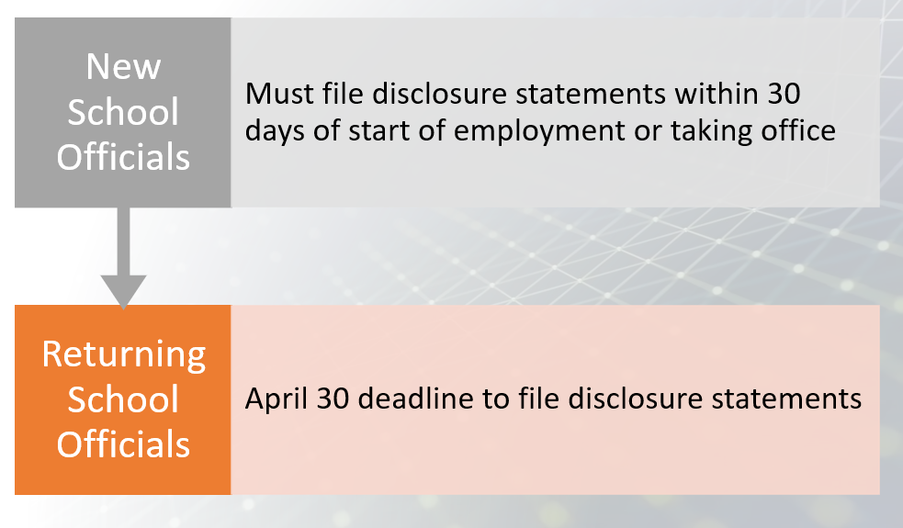
Disclosure Statements
Personal/Relative and Financial Disclosure Statements

Slide 9
If violation is found, SEC makes recommendation to Commissioner.
Penalties
REPRIMAND
Rebuke by Commissioner that conduct violated standards but does not result in a formal resolution.
CENSURE
Formal disapproval by Commissioner publicized by adoption of resolution.
SUSPENSION
Barred from engaging any activity/matter for a designated period of time.
REMOVAL
Immediate termination from Board membership or employment (if administrator).

Slide 10
Code of Ethics for School Board Members Only
N.J.S.A. 18A:12-24.1, N.J.A.C. 6A:28-6.4(a)
I will uphold and enforce all laws, rules and regulations of the State Board of Education, and court orders pertaining to schools. Desired changes shall be brought about only through legal and ethical procedures.
a.
Standards
Factual evidence shall include a copy of a final decision from any court of law or administrative agency of this State demonstrating that the respondent(s) failed to enforce all laws, rules and regulations of the State Board of Education, and/or court orders pertaining to schools or that the respondent brought about changes through illegal or unethical procedures.

Slide 11
Code of Ethics (continued)
I will make decisions in terms of the educational welfare of children and will seek to develop and maintain public schools that meet the individual needs of all children regardless of their ability, race, creed, sex, or social standing.
b.
Standards
Factual evidence of a violation shall include evidence that the respondent(s) willfully made a decision contrary to the educational welfare of children, or evidence that the respondent(s) took deliberate action to obstruct the programs and policies designed to meet the individual needs of all children, regardless of their ability, race, color, creed or social standing.

Slide 12
Code of Ethics (continued)
I will confine my board action to policy making, planning, and appraisal, and I will help to frame policies and plans only after the board has consulted those who will be affected by them.
c.
Standards
Factual evidence of a violation shall include evidence that the respondent(s) took official action to effectuate policies and plans without consulting those affected by such policies and plans, or took action that was unrelated to the respondent's duty to: i. Develop the general rules and principles that guide the management of the school district, the charter school, or the renaissance school project; ii. Formulate the programs and methods to effectuate the goals of the school district, the charter school, or the renaissance school project; or iii. Ascertain the value or liability of a policy.

Slide 13
Code of Ethics (continued)
I will carry out my responsibility, not to administer the schools, but, together with my fellow board members, to see that they are well run.
d.
Standards
Factual evidence of a violation shall include, but not be limited to, evidence that the respondent(s) gave a direct order to school personnel or became directly involved in activities or functions that are the responsibility of school personnel or the day-to-day administration of the school district, charter school, or the renaissance school project.

Slide 14
Code of Ethics (continued)
I will recognize that authority rests with the board of education and will make no personal promises nor take any private action that may compromise the board.
e.
Standards
Factual evidence of a violation shall include evidence that the respondent made personal promises or took action beyond the scope the respondent’s duties such that, by its nature, had the potential to compromise the district board of education or the board of trustees.

Slide 15
Code of Ethics (continued)
I will refuse to surrender my independent judgment to special interest or partisan political groups or to use the schools for personal gain or for the gain of friends.
f.
Standards
Factual evidence of a violation shall include evidence that the respondent(s) took action on behalf of, or at the request of, a special interest group or persons organized and voluntarily united in opinion and who adhere to a particular political party or cause; or evidence that the respondent(s) used the schools to acquire some benefit for the respondent(s), a member of the respondent’s immediate family or a friend.

Slide 16
Code of Ethics (continued)
I will hold confidential all matters pertaining
to the schools which, if disclosed, would needlessly injure individuals or the schools. In all other matters, I will provide accurate information and, in concert with my fellow board members, interpret to the staff the aspirations of the community for its school.
g.
Standards
Factual evidence of a violation of the confidentiality provision shall include evidence that the respondent(s) took action to make public, reveal or disclose information that was not public under any laws, regulations or court orders of this State, or information that was otherwise confidential in accordance with board policies, procedures or practices. Factual evidence that the respondent(s) violated the inaccurate information provision shall include evidence that substantiates the inaccuracy of the information provided by the respondent(s) and evidence that establishes the inaccuracy was other than a reasonable mistake or personal opinion or was not attribute to developing circumstances.

Slide 17
Code of Ethics (continued)
I will vote to appoint the best qualified personnel available after consideration of the recommendation of the chief administrative officer.
h.
Standards
Factual evidence shall include evidence that the respondent(s) acted on a personnel matter without a recommendation of the chief administrative officer.

Slide 18
Code of Ethics (continued)
I will support and protect school personnel in proper performance of their duties.
i.
Standards
Factual evidence of a violation shall include evidence that the respondent(s) took deliberate action that resulted in undermining, opposing, compromising or harming school personnel in the proper performance of their duties.

Slide 19
Code of Ethics (continued)
I will refer all complaints to the chief administrative officer and will act on the complaints at public meetings only after failure of an administrative solution.
j.
Standards
Factual evidence of a violation shall include evidence that the respondent(s) acted on or attempted to resolve a complaint, or conducted an investigation or inquiry related to a complaint: i. Prior to referral to the chief administrative officer; or ii. At a time or place other than a public meeting and prior to the failure of an administrative solution.

Slide 20
Some Cases Related to the Code of Ethics
C20-20. On own, member contacted vendors & districts for prices to go from MacBooks to Chromebooks. Can express disagreement at Board meeting, but inappropriate to conduct private investigation. Effectuated plans without consulting with those who will be impacted and placed Board at risk. Censure. N.J.S.A. 18A:12-24.1 (c), (e).
C25-21. Member met with members of public to “justify her actions” for a walk-on motion of a highly divisive Board action to change a holiday name. This independent action undermined the Board’s decision-making process as it is up to the Board to publicly discuss/explain the rationale for its decisions. It also undermined the administration’s authority and imposes an unnecessary strain on the Administration/Board relationship. Reprimand. N.J.S.A. 18A:12-24.1(e).
C86-21. A Board member, as secretary of a local organization, was told by principal that chorus would not be performing in an annual event so texted chorus teacher to question why. Request for explanation from subordinate was administering schools, gave appearance that Board disagreed with administration, put chorus teacher in uncomfortable situation, and was tantamount to an investigation prior to referral to the superintendent. Violated N.J.S.A. 18A:12-24.1 (d), (e), (i), (j). Censure.

Slide 21

Prohibited Acts (N.J.S.A. 18A12-24)
Below is an except. For full content see: https://www.nj.gov/education/ethics/coi.shtml
 | Recuse yourself if there is a benefit to you (school official) or your immediate family due to:
a. | Business interest or professional activity in conflict.
b. | Use of position to secure unwarranted privileges, advantages or employment. Extends to “others” so may go beyond definition of immediate family.
c. | Financial involvement that may impair objectivity.
d. | Service or employment that may prejudice independent judgement.
e. | Gift, favor, etc. offered with intent to influence.
f. | Financial gain.
 | Other Considerations:
g. | Shall not represent any person/party other than Board/district in matter before the Board.
h. | Not a conflict if not accruing a greater gain than any others.
i,j,k | (See N.J.S.A. 18A:12-24)

Slide 22

Conflict and Recusal
When a conflicted board member votes, there is a distinction between recusal and abstention. If a board member has a legal conflict of interest on a matter, they should RECUSE from the discussion and the vote – not abstain.
Abstaining from a matter is not sufficient to memorialize the fact that a board member has a legal conflict and not eligible/able to vote. Instead, they must vocalize that they are recused.
When a board member needs to recuse due to a legal conflict of interest, board counsel should advise on how the recusal impacts both quorum and the recording of votes.

Slide 23

Relationship Definitions
N.J.A.C. 6A:23A-1.2
Immediate Family Member: spouse, civil union/domestic partner, or dependent child residing in the same household.
Relative: Spouse, civil union/domestic partner or parent, child, sibling, aunt, uncle, niece, nephew, grandparent, grandchild, son/daughter-in-law, stepparent, stepchild, stepbrother/sister, half-brother/sister of the individual or the individual’s spouse or partner by blood, marriage, or adoption. (Nepotism law).
Although term “relative” does not appear in Prohibited Acts or Code of Ethics, a relative can create a conflict.
Anyone not listed may be considered an “other” if a conflict exists.

Slide 24
Hiring/
Personnel
If the relative already works in the district:
An administrator may not exercise direct or indirect authority over their relative.
A board member may not take part in employment matters concerning CSA or supervisors in chain of command between the relative and CSA.
A board member may not take part in the search, selection or vote to hire a new CSA, and post-hire evaluations and contract discussions.
May not hire the relative of a board member or chief school administrator. (Limited exceptions.)

Slide 25
Collective Bargaining
A24-17
Relationship to Board Member | Current Member of a Statewide Public Teachers’ Union | Participate in Negotiations Yes or No | Vote to Ratify the Contract Yes or No
Spouse Dependent Child Child (not dependent) Relative | Works in the District | No | No
Self Spouse Dependent Child | Works Out-of-District | No | Yes* **
Child (not dependent) Relative | Works Out-of-District | Yes* | Yes*
* Absent another conflict –Heightened union involvement, linkage
** After Memorandum of Agreement, salary guides, total compensation package attained.

Slide 26

Impact on Committee Assignments when Relative Works In-District A05-23:
Board president - child is instructional assistant in district.
Cannot choose any committee members nor be on any committee(s) involving the local education association or matters related to Superintendent. May not choose the chair, members, and/or serve on any committee that remotely touches upon or directly relates to family members’ employment including, but not limited to the personnel, negotiations, instructional, and finance committees.
Board member B’s spouse is 10-month employee in technology department.
Cannot be involved in any and all matters (including service on a committee(s)) that remotely touch upon or directly relate to the spouse’s employment including, without limitation, the personnel, negotiations, and/or finance committees.

Slide 27
Volunteering in School
A07-00, A32-14, A10-15, A17-15, A15-18
Serving on the Board does not prevent volunteerism in the schools, but consideration needs to be given to:
Degree of involvement with staff and students (Frequency/Level of Interaction) | Degree of authority to give and receive directions/ orders to staff and students
What is the degree of:
Giving directions or orders to staff or students
Taking orders from staff
Will I be in the building often? (“enmeshed in the building”)
Will I be handling the school district’s money?
Will I be the lead/regular volunteer or coach for a school district club, activity or sport?
Advise superintendent you will be performing this work.
Refrain from any related Board discussion or vote.
Always be cognizant of the obligations of the Act.

Slide 28

Social Media
As a general matter, a school official does not violate the Act merely because they engage in social media activity. Instead, the Commission’s analysis is guided by whether a reasonable member of the public could perceive that the school official is speaking in his or her official capacity or pursuant to his or her official duties.
Depends in large part on the content of the speech. If the speech in question has no correlation or relationship to the business of the Board and/or its operations and, therefore, could not possibly be regarded as a statement or position on behalf of the Board (as a body), a school official will not violate the Act. Conversely, if the speech in question does relate to the business of the Board and/or its operations, it is then reasonable to perceive the speech as being offered in an official capacity and pursuant to his or her official duties.
C106-22, C103-22, C03-23, C13-23, C20-22

Slide 29

Disclaimer Q & A
If I use a disclaimer, does that automatically protect me from being in violation of the Act?
No, but it does help clarify the capacity in which you are speaking.
What could cause me to be in violation with a disclaimer?
Based on the content, if a reasonable member of the public could perceive you are speaking in official capacity or pursuant to official duties, that could make the disclaimer inadequate and of no force or effect.
If I don’t use a disclaimer does that mean I am automatically in violation of the Act?
No, regardless if a disclaimer was used or not, capacity speaking from, content, & perception matter.
Must I use the exact disclaimer wording from the SEC?
The failure to parrot the exact language recommended will not mean that did not use an appropriate disclaimer.

Slide 30

Ethics Reminder
In Closing:
Board members may not deliberately disregard and ignore the ethical standards that they are required, by law, to uphold and enforce. When Board members do so, it not only threatens the integrity of the Board, it also unnecessarily compromises District personnel and subverts the very purpose for which Board members are elected – namely, to serve the needs of the school district and its students.
C45-22

Slide 31

Roles and Responsibilities

Slide 32

Overview of Roles A Board represents:
The state
Board members are state officials empowered by state law to govern public schools at a local level.
All students – every policy and action should be based on what is best for the education of all students. There will be competing interests so the Board must make decisions on facts and data grounded in a commitment to ensuring all students receive a high-quality public education.
The entire community – ensure two-way communication and inform/engage the community in the work of our schools.

Slide 33


Overview of Roles
Administration Perspective
Proper Board Perspective

Slide 34
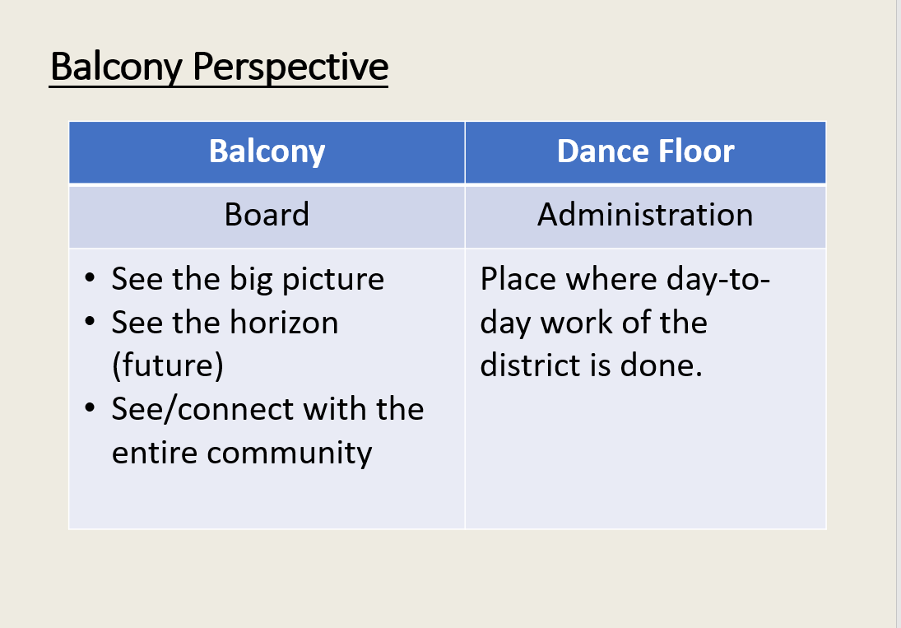
The Board must discipline themselves to resist the allure of the
dance floor and to stay focused on the work that the Board is empowered to do.

Slide 35
Overview of Roles – Board/Superintendent
BOARD
Oversees that schools are well run.
WHAT
CSA
Runs the schools.
HOW

Slide 36
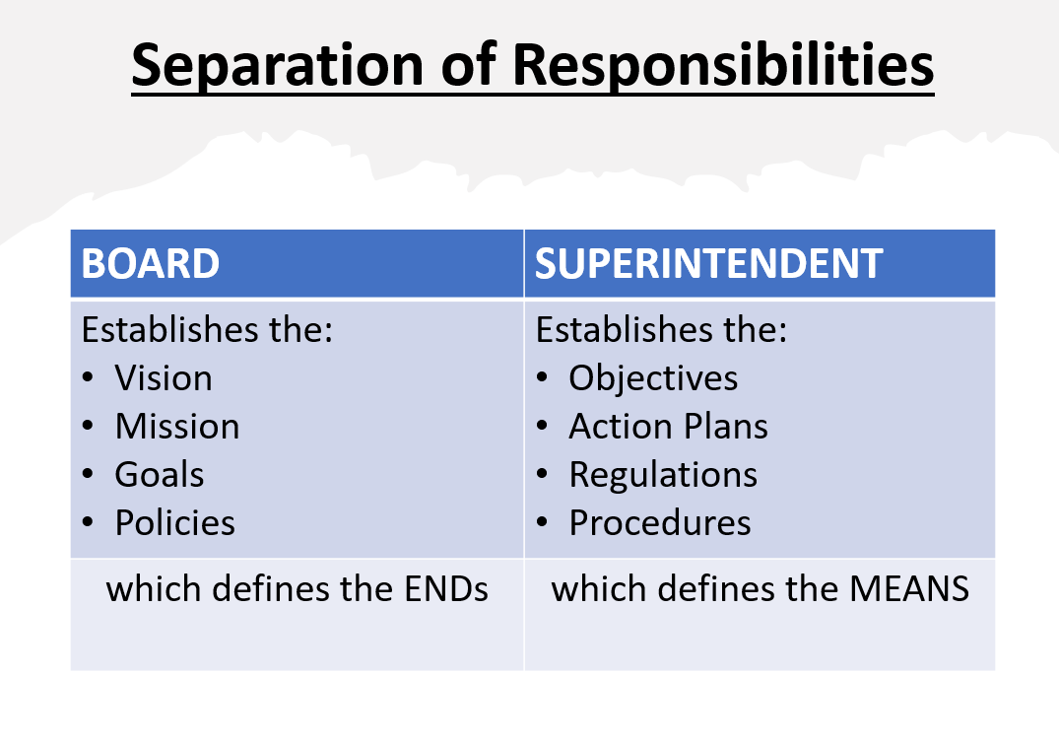

Slide 37
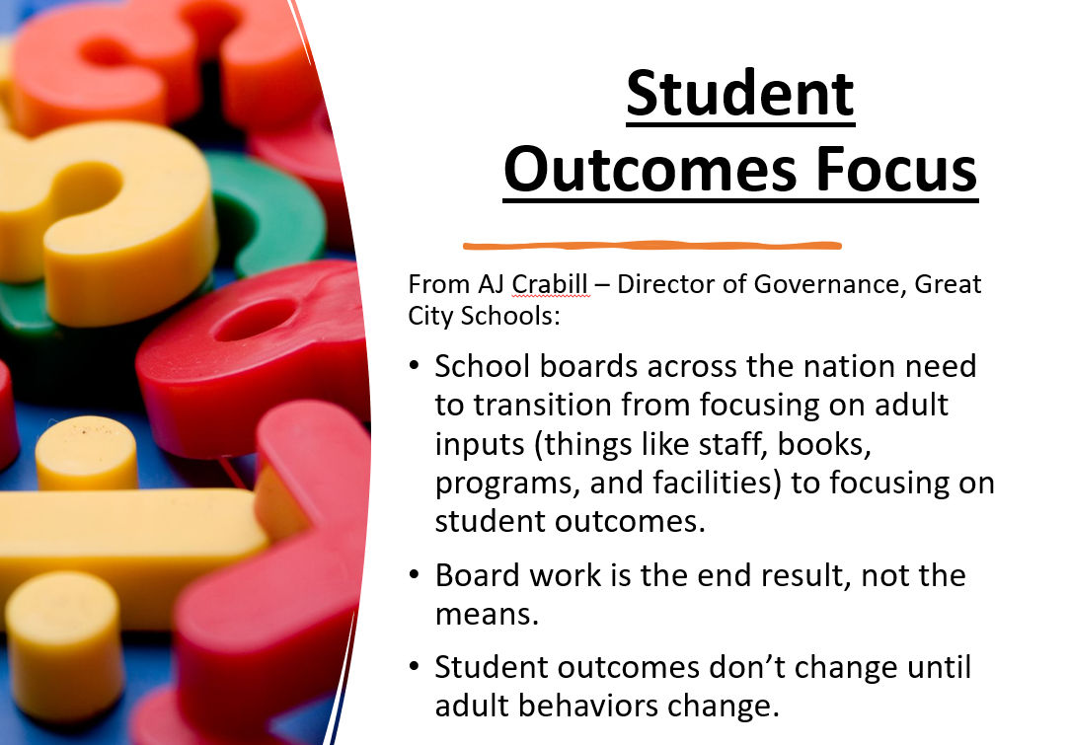

Slide 38
Functions of the Board of Education
4 Functions of a Board of |  |  | Guidance through Policy development
 |  |  | Planning Set clear expectations for success that includes a guiding mission and vision, and long and short- term goals.
 |  |  | Oversight and Appraisal Evaluate the CSA and hold them accountable, monitor the effectiveness of policies, and assess student achievement results
 |  |  | Provide for 2-way communication between the community and the district.
Education

Slide 39
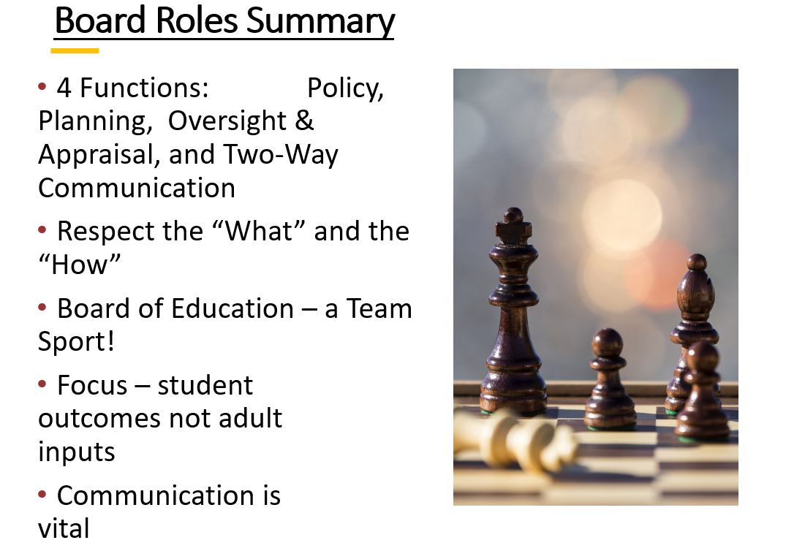

Slide 40
Board-Superintendent Relationship
The Board-Superintendent Collaborative Relationship
Board
Respect Superintendent as consultant before taking action
CSA
Keep the board informed at all times.
Recognize Superintendent as community’s educational leader.
Effectively and efficiently implement the district’s policies and evaluate the results.
Do not confuse your policy role with that of running
the schools.
Recognize the board as the final authority and convey it to the staff.
Do not surprise the superintendent.
Do not surprise the board.

Slide 41
Tips for Board Member Effectiveness
Stay strategic. The bottom line is the children, not adults. Do not get distracted by administrative issues that you are not responsible for.
DO NOT:
Get involved in the day-to-day operation of the school district or frequent the board office or schools (except as parent or board business).
Contact staff directly. Board has 1 employee – the superintendent. Take on a task that is the job of a staff member.
Engage in practices outside the chain of command.
Make individual requests to the superintendent outside the work of the Board.

Slide 42
In Summary - Roles
Working together
Board as governing body and community representative
Superintendent as chief administrative officer and educational leader
to advance student achievement

Slide 43
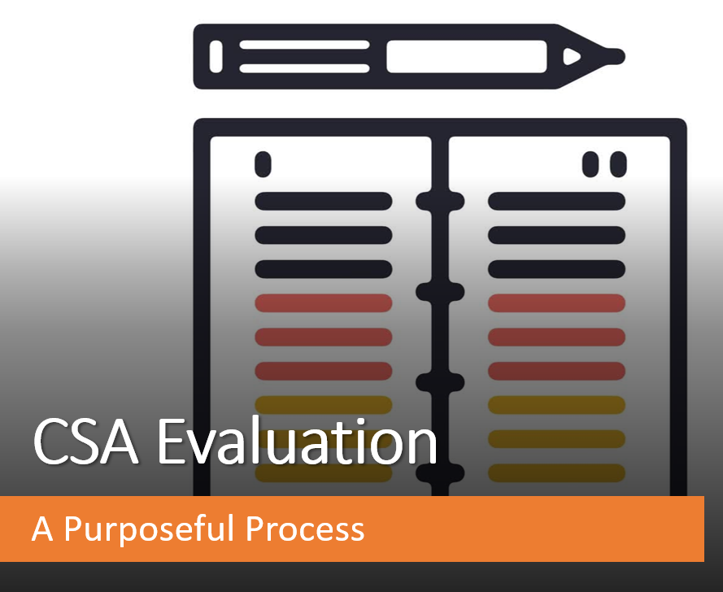
Presented by NJSBA Field Services

Slide 44

Purpose of Annual Evaluation
N.J.A.C. 6A:10-8.1(b)
Purpose of the Annual CSA Evaluation:
Promote professional excellence and improve the skills of the CSA.
Improve the quality of education received by the students we serve.
Provide a basis for the review of the CSA’s performance.

Slide 45
Legal Guidelines
N.J.S.A. 18A:17-20.3a
Board shall evaluate performance of superintendent at least once a year.
Evaluation shall be in writing.
Board and superintendent shall meet to discuss findings.
Evaluation will be based on goals and objectives of district, responsibilities of superintendent and other such criteria prescribed by State Board of Education.
N.J.A.C. 6A:10-8.1
Annual performance report shall be prepared by July 1 by majority of Board’s total membership and shall include:
Areas of strength
Areas needing improvement
Recommendations for professional growth
Indicators of student progress and growth
Summary conference meeting shall include a majority of the total Board membership.

Slide 46
NJQSAC Requirements
Evidence of training: Governance 1
July 1 evidence – dated and signed copy of evaluation, meeting minutes

Slide 47
Evaluation Process
District Goal Setting and Action Plans
District Goals
Progress Updates
Superintendent
Evaluation Pre-Conference
BOE
Non-conflicted Board Members Meet to Review Compiled Superintendent Evaluation Results and Develop Majority Opinion Annual Performance Report
BOE
Completes Individual superintendent Evaluations
Superintendent
Completes District Goals
Self-Assessment and Evidence
for Leadership Standards
Annual Summary Conference
Non-Conflicted Board Members Meet with Superintendent to Discuss Annual Performance Report
Board President and Superintendent
Sign and Date the Annual
Performance Report

Slide 48
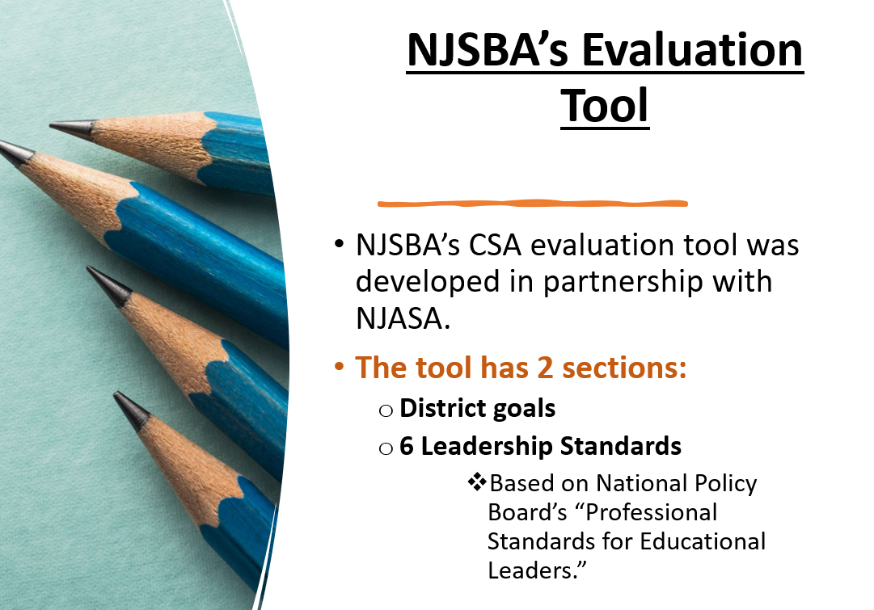

Slide 49
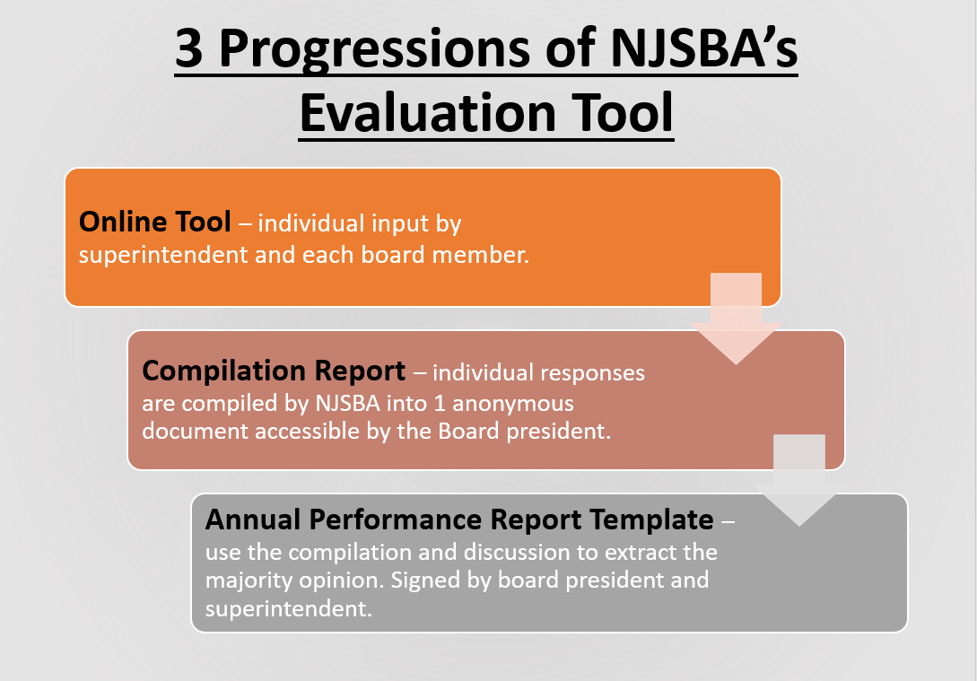

Slide 50
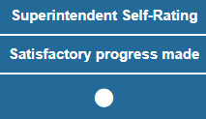

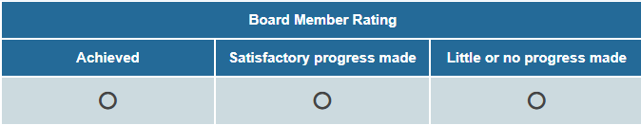

1. Goals Portion of Online Evaluation Tool
Board members will consider for each district goal input by the CSA, the CSA’s self-assessment and evidence: comments/links.
Each board member will provide their rating for each goal and comments
to their fellow board members to support their rating.

Slide 51

1. Standards Portion of Online Evaluation Tool
Mission, Vision, & Core Values
Governance, Ethics, & Professional Norms
Rating Scale
Exemplary
Proficient
Area for Growth
Unsatisfactory
Not Observed
Operations Management
Curriculum, Instruction, Assessment, and School Improvement
Community of Care, Equity, and Family Engagement
Professional Capacity/ Community of School District Personnel

Slide 52
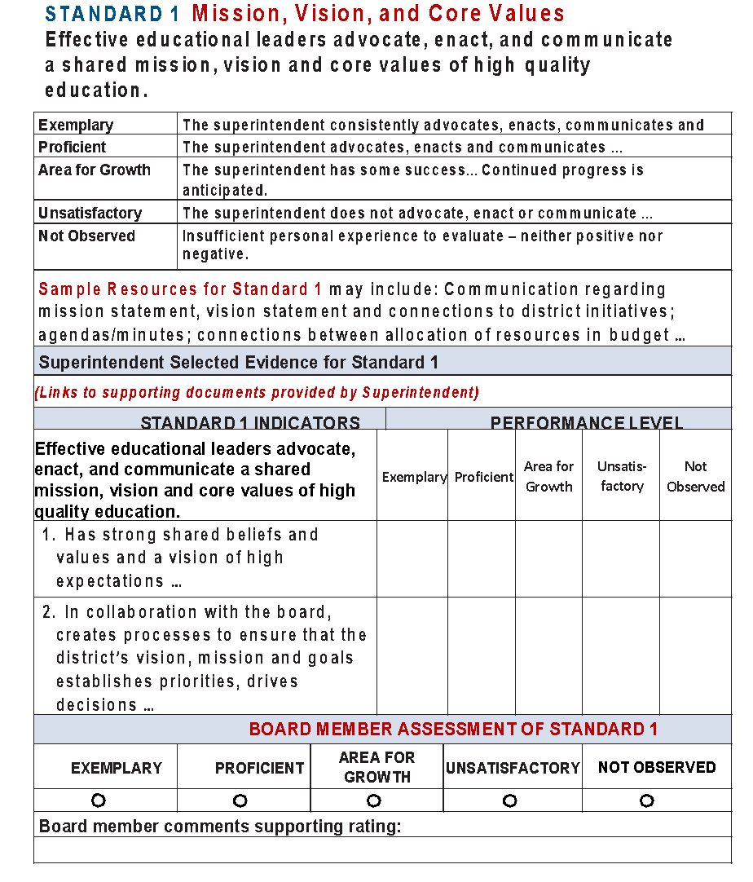
Standard 1 Example
Standard
Rating scale definition specifically for this standard
Resources to
Consider
Evidence links provided
by School Leader
Indicator ratings
help determine
overall standard
rating
Indicators
X
X
Overall rating of performance
on the standard
Board member
comments

Slide 53
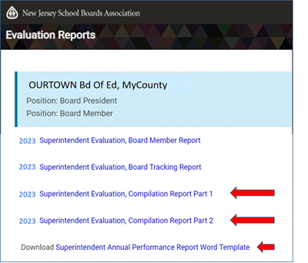
2nd Progression – NJSBA Compilation
NJSBA automatically compiles reports of the individual input. When the last member is done, the reports are ready.
Access to the reports is
available to the Board
President. The FSR
will send an email with
access instructions.
The Board will use these
2 reports to complete the
Annual Performance Report template – the CSA’s Evaluation.
+
=

Slide 54
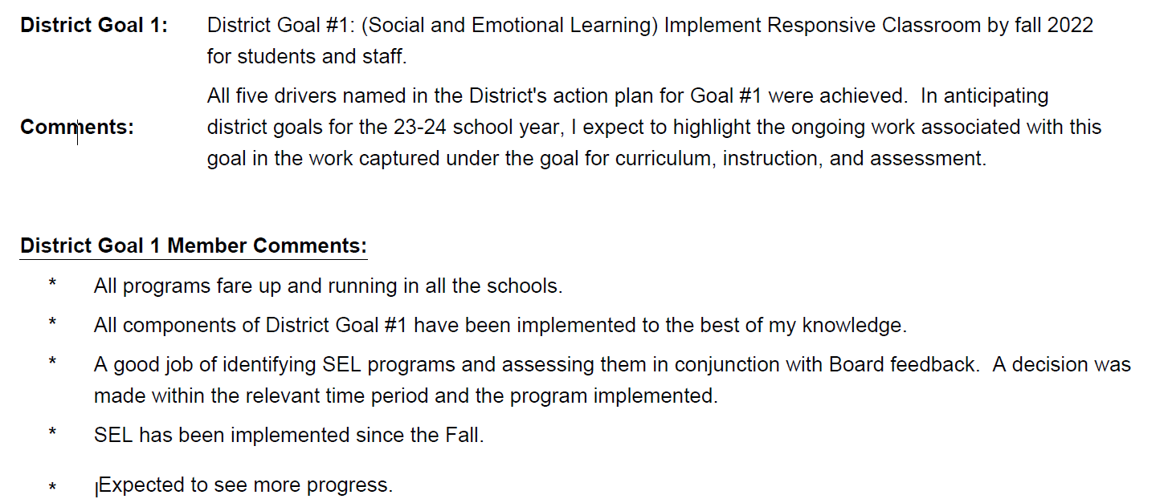
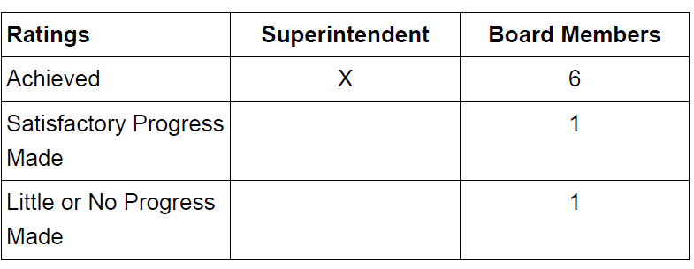
Compilation Report – Goal Example

Slide 55
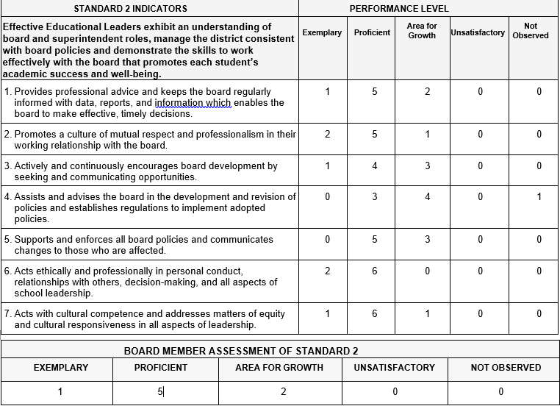
Compilation Report – Standard Example
Board members comments also displayed.

Slide 56

Transition from Compilation to
Annual Performance Report
Compilation
Reports
from NJSBA
accessed by
Board president
Everyone’s individual opinions.
Working document for Board.
Consensus based on
Compilation and Board discussion
Annual Performance
Report
Blank NJSBA template
Prepared by Board president
or designee
Represents views of
Board majority.
Superintendent’s actual
evaluation to be signed.

Slide 57
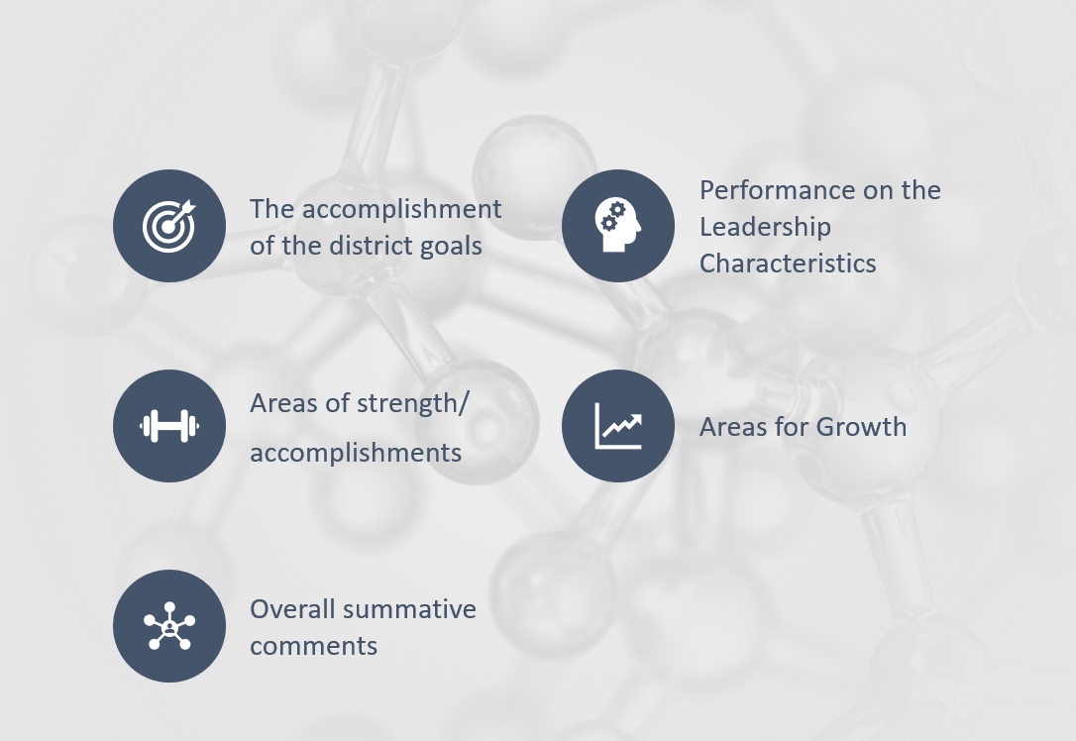
3rd Iteration of NJSBA’s Evaluation Tool –
Annual Performance Report Template
Signature lines for the Board
President and Superintendent

Slide 58
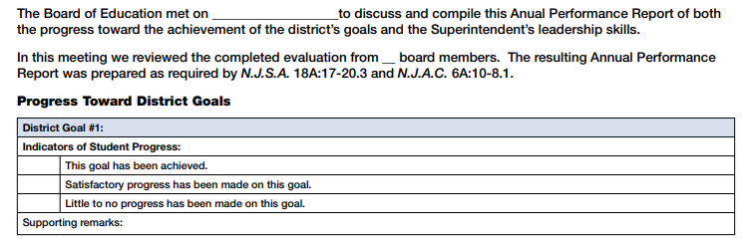

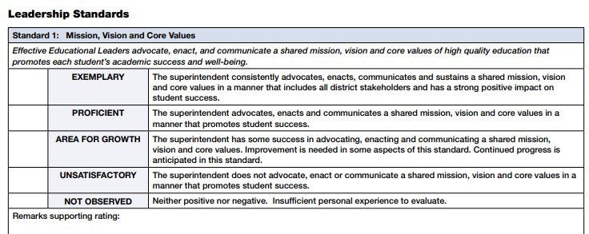

Annual Performance Report Template
Based on
majority
opinion.

Slide 59
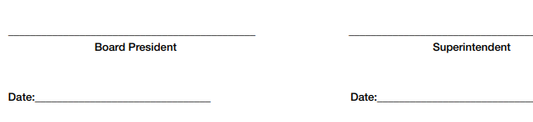
Annual Performance Report
Template
Summary of overall areas of strength and areas for growth.
Can check more than one box.
Open-ended text box.

Slide 60
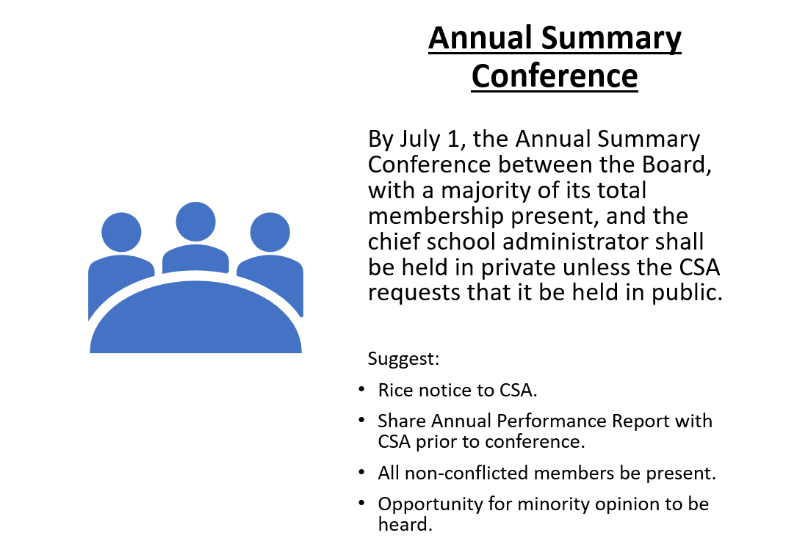

Slide 61

Sample Evaluation Calendar
When | Action
Late March or Early April (Depending on timing of meeting schedule) | Board and CSA meet in Executive Session for Evaluation Preconference and clarify process/timelines
Late April – Early May | CSA competes their portion of the evaluation.
Mid-May | Members complete their individual evaluation.
Mid-May | NJSBA compiles individual responses into anonymous Compilation reports retrieved by board president.
End May (Consider May board meeting) | Board meets in Executive Session to review compilation and identify majority opinion.
June | Annual Performance Report is written by the Board president or designee.
By July 1 (Consider last June board meeting) | Annual Summary Conference to discuss evaluation attended by superintendent and at least a majority of the full membership of the Board. Suggest all non-conflicted members.
Start with July 1
deadline & work
backwards

Slide 62

Summary of Effective Evaluation Process
All voices heard individually – Board & CSA.
Board consensus on the majority opinion.
Rights of the minority opinion to be heard.
Building a productive CSA – Board partnership.
Compliance with statute and code.
A framework for student success.

